Slide 1
Labour (分娩)
the sequence of events that leads to the birth of a baby
a few weeks before birth
the foetus changes its position so that its head is downwards just above the cervix

Slide 2
Labour (分娩)
the sequence of events that leads to the birth of a baby
when labour begins
the muscles of the uterus contract regularly
the contractions gradually become more frequent and powerful

Slide 3
The process of birth
includes three main stages:
dilation of the cervix
expulsion of the foetus
expulsion of the placenta

Slide 4
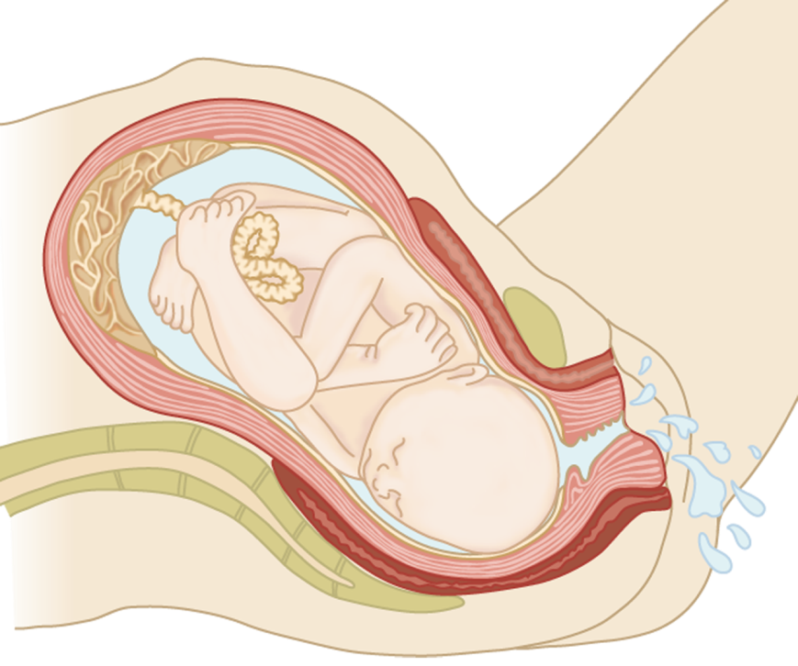
Dilation of the cervix
the cervix dilates to let the head of the foetus pass through
cervix

Slide 5

Dilation of the cervix
the amnion breaks and the amniotic fluid flows out through the vagina
amnion
amniotic fluid
helps lubricate the vagina for the passage of the foetus

Slide 6

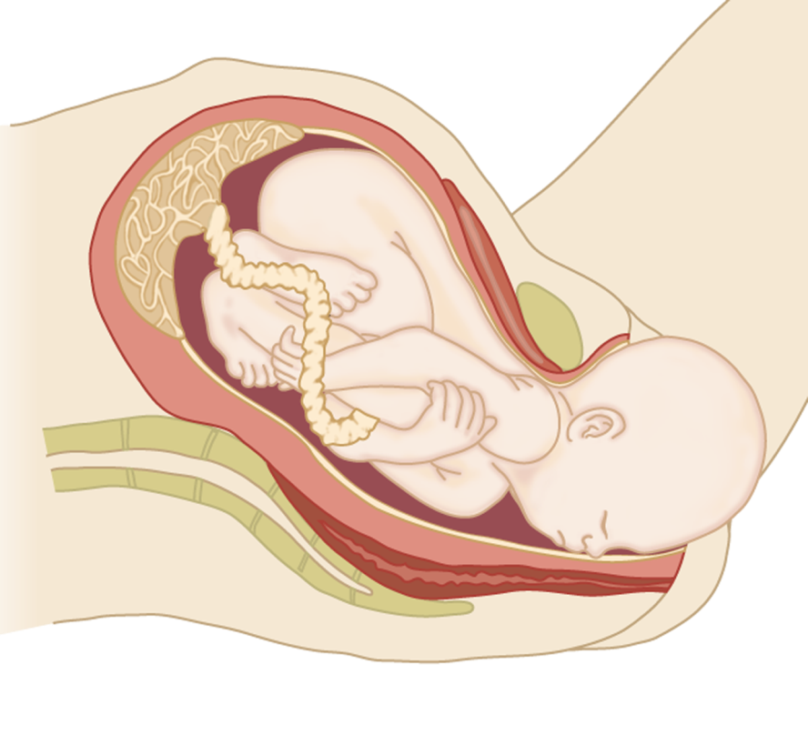
Expulsion of the foetus
the muscles of the uterus and the abdominal muscles contract strongly
abdomen
push the foetus head-first through the cervix and vagina
uterus

Slide 7
Expulsion of the foetus
the umbilical cord is clamped and cut
umbilical cord
the remains of the cord on the baby’s body dries up and falls off
➢ form a scar (navel)

Slide 8
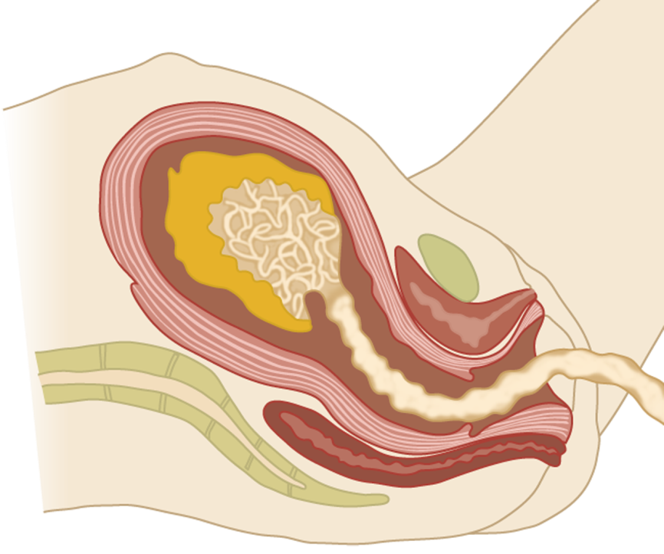
Expulsion of the placenta
continued contractions of the uterus cause the placenta to detach from the uterine lining
the placenta passes out through the vagina
placenta detaching

Slide 9
https://www.youtube.com/watch?v=dYu-0rOnLpA
https://www.youtube.com/watch?v=xyN48VnRYUY

